Slide 1
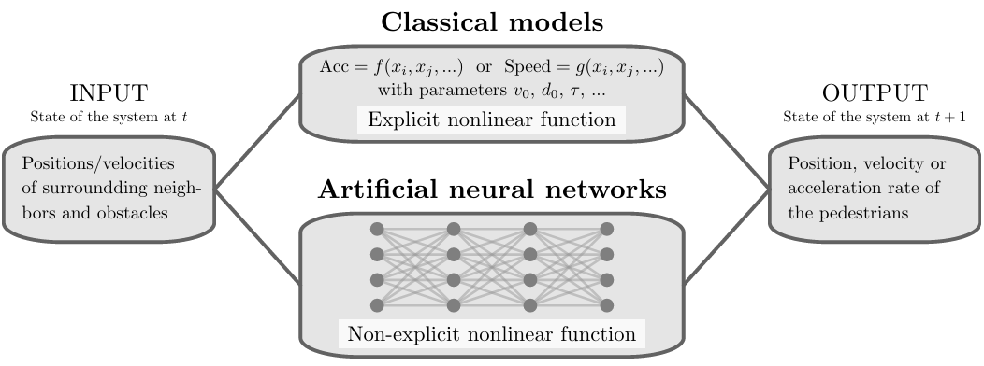
Background of the Research
"Prediction of Pedestrian Speed with Artificial Neural Networks"
by Antoine Tordeux, Mohcine Chraibi, Armin Seyfried, and Andreas Schadschneider

Slide 2
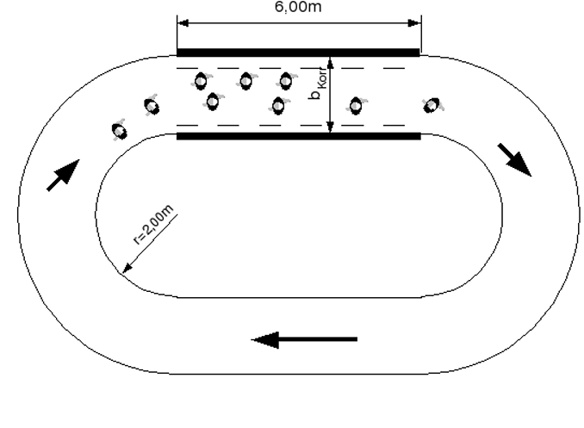
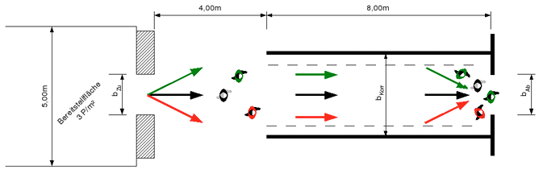
Background of the Research – Data
Project HERMES
Laboratory conditions
Unidirectional
Ring data
Bottleneck data
Sampling frequency 16Hz
50%/50% train-test-split

Slide 3
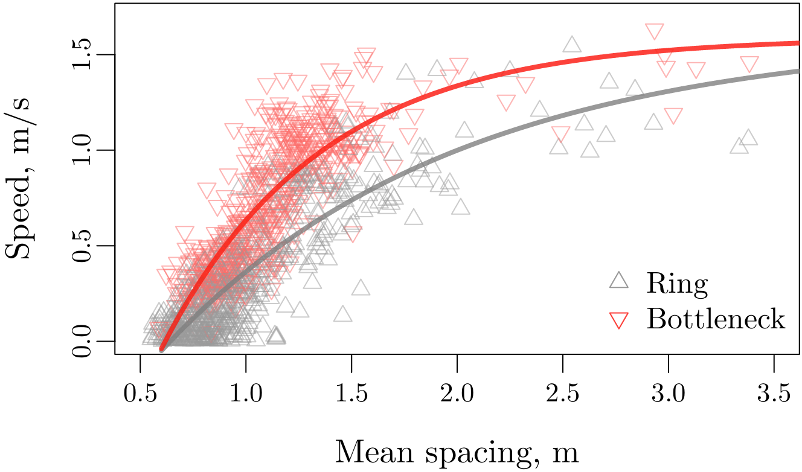
Background of the Research – Data

Slide 4

Background of the Research – Models
Weidmann model
$$v=v_{0}\left(1−\exp\left(\frac{l−{\overline{s}}_{K}}{v_{0}T}\right)\right)$$
Artificial neural network
$$v=NN\left(H, {\overline{s}}_{K},\left(x_{1}−x, y_{1}−y\right), …, \left(x_{K}−x, y_{K}−y\right)\right)$$

Slide 5
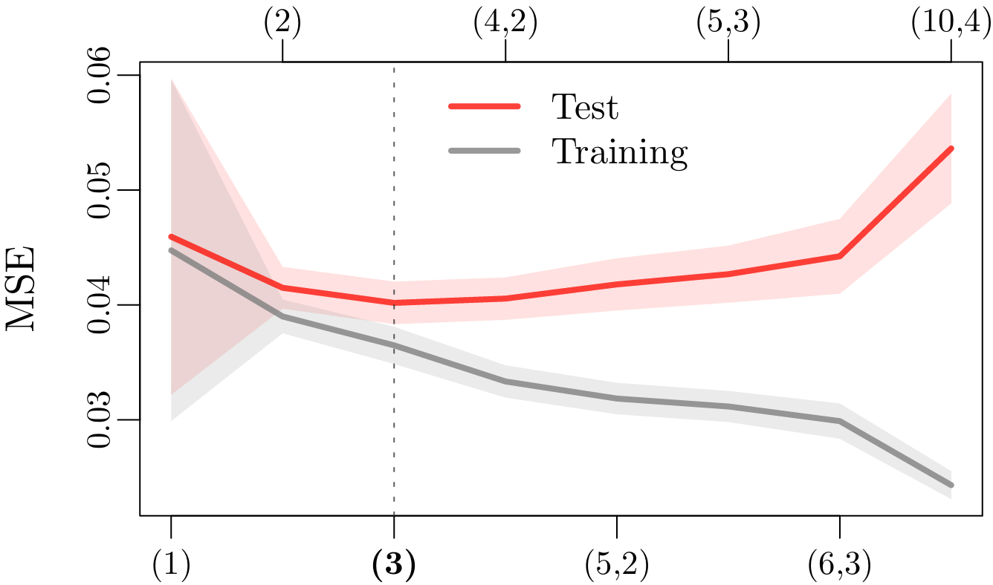
Background of the Research – Results

Slide 6
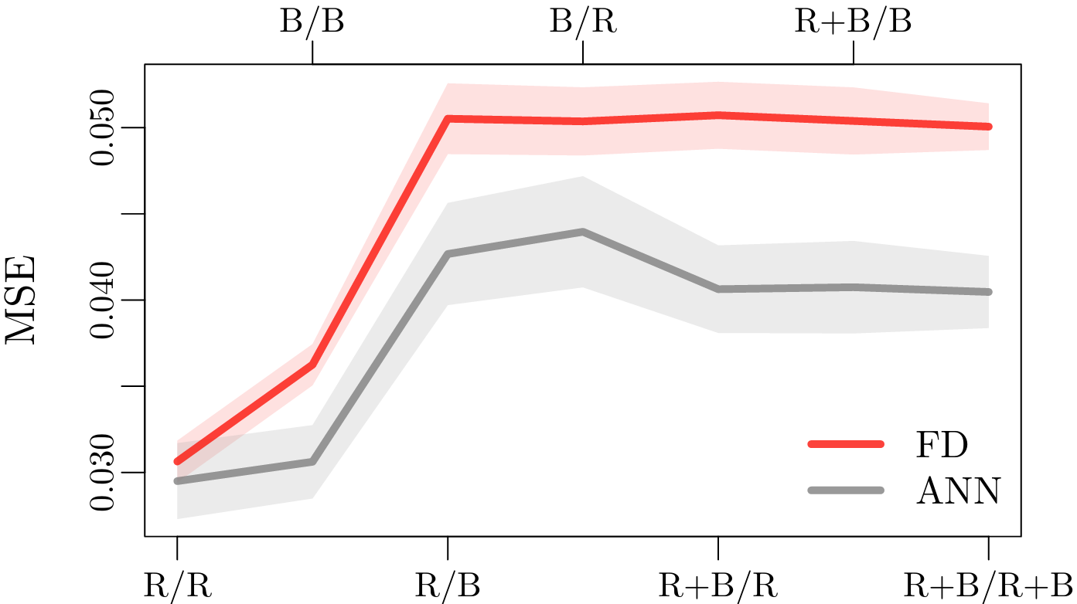
Background of the Research – Results

Slide 7
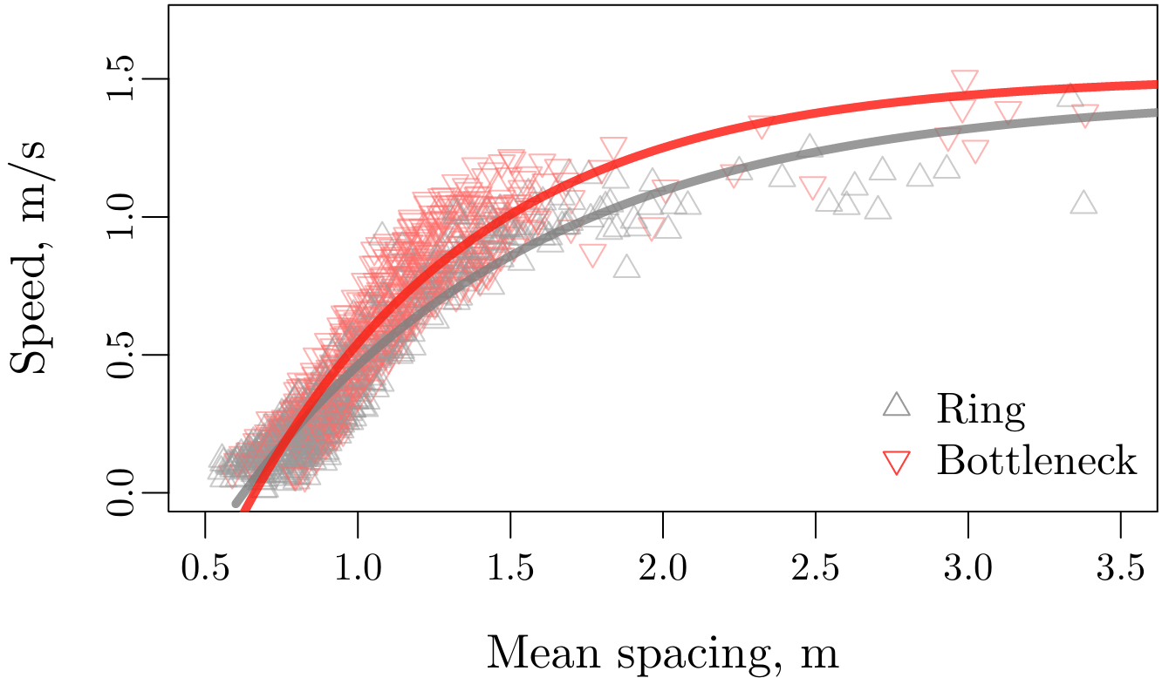
Background of the Research – Results

